Slide 1
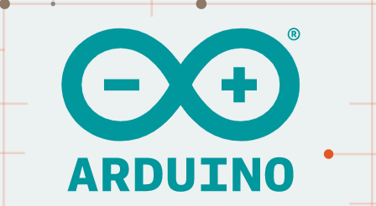
Arduino Uno
How to work with Arduino and analog Sensors.

Slide 2
Arduino Uno
How to work with Arduino and analog Sensors.

Slide 3
Contents
Introduction
Know your Hardware
Arduino terminology
Arduino Software
Write your first program

Slide 4
What is Arduino
Arduino is an open-source electronics platform based on easy-to-use hardware and software. Arduino boards are able to read inputs - light on a sensor, a finger on a button, or a Twitter message - and turn it into an output - activating a motor, turning on an LED, publishing something online. You can tell your board what to do by sending a set of instructions to the microcontroller on the board. To do so you use the Arduino programming language (based on Wiring), and the Arduino Software (IDE), based on Processing.
Source: https://www.arduino.cc/en/Guide/Introduction

Slide 5
Arduino Vs Raspberry Pi
- Performance: Raspberry Pi
- Power Consumption: Arduino
- GPIO: Arduino (analog pins!)
- Cost: Arduino
- Programming language support: Raspberry Pi
- Functionality: Raspberry Pi
Image Source: http://karma-laboratory.com/workshops/arduinoforprogrammers/images/arduino_variants.jpg

Slide 6
Sample Arduino Family

Slide 7
Arduino HW

Slide 8
Technical specifications
MICROCONTROLLER | ATmega328P
OPERATING VOLTAGE | 5V
INPUT VOLTAGE (RECOMMENDED) | 7-12V
INPUT VOLTAGE (LIMIT) | 6-20V
DIGITAL I/O PINS | 14 (of which 6 provide PWM output)
PWM DIGITAL I/O PINS | 6
ANALOG INPUT PINS | 6
DC CURRENT PER I/O PIN | 20 mA
DC CURRENT FOR 3.3V PIN | 50 mA
FLASH MEMORY | 32 KB (ATmega328P) of which 0.5 KB used by bootloader
SRAM | 2 KB (ATmega328P)
EEPROM | 1 KB (ATmega328P)
CLOCK SPEED | 16 MHz
LED_BUILTIN | 13
LENGTH | 68.6 mm
WIDTH | 53.4 mm
WEIGHT | 25 g

Slide 9
Boards
The board selection has two effects: it sets the parameters (e.g. CPU speed and baud rate) used when compiling and uploading sketches; and sets and the file and fuse settings used by the burn bootloader command. Some of the board definitions differ only in the latter, so even if you've been uploading successfully with a particular selection you'll want to check it before burning the bootloader. You can find different boards here.
Source:https://www.arduino.cc/en/hardware

Slide 10

Arduino IDE
Arduino Software (IDE) includes the built in support for the boards in the following list, all based on the AVR Core. The Boards Manager included in the standard installation allows to add support for the growing number of new boards based on different cores like Arduino Due, Arduino Zero, Edison, Galileo and so on.
Source: https://www.arduino.cc/en/software

Slide 11
Sketch – A program that runs on the board
Pin – A port that is connected to an input/output channel.
Digital – 1 (HIGH) or 0 (LOW)
Analog - 0 - 255

Slide 12
Sketch – A program that runs on the board
Pin – A port that is connected to an input/output channel.
Digital – 1 (HIGH) or 0 (LOW)
Analog - 0 - 255

Slide 13
Getting Started
Download and Install Arduino IDE from : https://www.arduino.cc/en/Main/Software
Connect the Arduino to your host machine with a USB A to B device cable.
Connect your sensor to Arduino board
Develop code on the IDE and upload!
Verify output on Serial Monitor/Plotters
Notes:
Consider talking about:
Automatic (software) reset

Slide 14
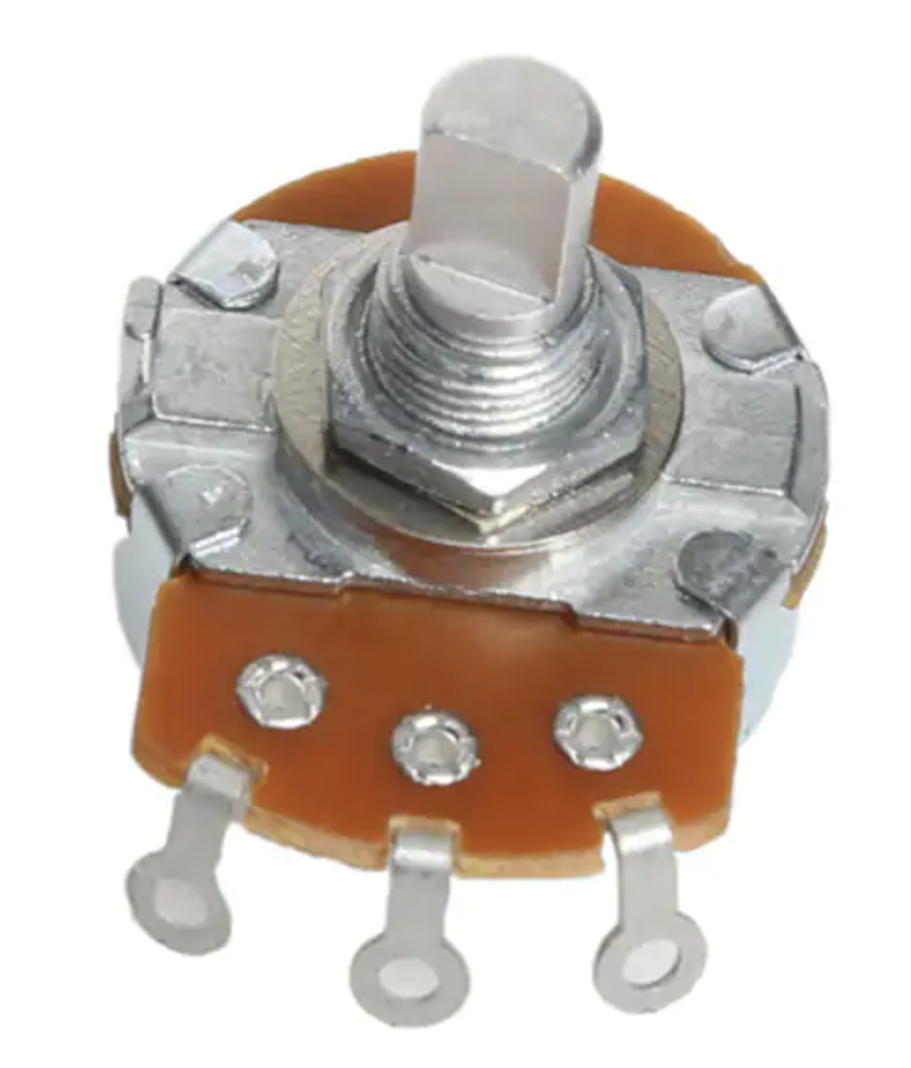
Potentiometer
Know your sensor
Analog potentiometer is a three-terminal resistor in which the resistance is changed manually to control the flow of electric current. An analog or mechanical potentiometer is called a pot because of its pot-like structure. The digital potentiometer can automatically change the resistance based on the given condition.
Notes:
Consider talking about:
Automatic (software) reset

Slide 15
Demo
Unboxing
IDE GUI walk through
Know your Sensor and connection
Write sample program
Notes:
Consider talking about:
Automatic (software) reset

